Slide 1

Introduction to Probability and Statistics
Twelfth Edition
Robert J. Beaver • Barbara M. Beaver • William Mendenhall
Presentation designed and written by:
Barbara M. Beaver

Slide 2
Introduction to Probability and Statistics
Twelfth Edition
Chapter 8
Large-Sample Estimation
Some graphic screen captures from Seeing Statistics ®
Some images © 2001-(current year) www.arttoday.com

Slide 3
Introduction
Populations are described by their probability distributions and parameters.
  For quantitative populations, the location and shape are described by μ and σ.
  For a binomial populations, the location and shape are determined by p.
If the values of parameters are unknown, we make inferences about them using sample information.

Slide 4
Types of Inference
Estimation:
  Estimating or predicting the value of the parameter
  “What is (are) the most likely values of μ or p?”
Hypothesis Testing:
  Deciding about the value of a parameter based on some preconceived idea.
  “Did the sample come from a population with μ = 5 or p = .2?”

Slide 5

Types of Inference
Examples:
  A consumer wants to estimate the average price of similar homes in her city before putting her home on the market.
Estimation: Estimate μ, the average home price.
  A manufacturer wants to know if a new type of steel is more resistant to high temperatures than an old type was.
Hypothesis test: Is the new average resistance, μ_{Ν} equal to the old average resistance, μ_{Ο}?

Slide 6
Types of Inference
Whether you are estimating parameters or testing hypotheses, statistical methods are important because they provide:
  Methods for making the inference
  A numerical measure of the goodness or reliability of the inference

Slide 7
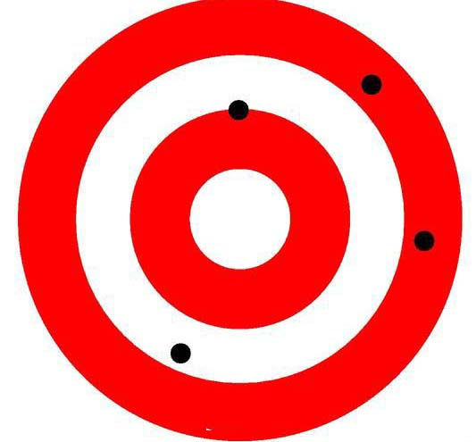
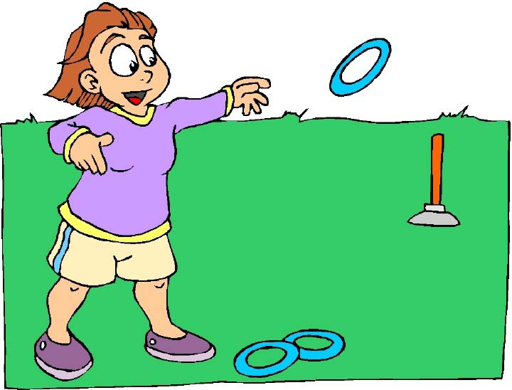
Definitions
An estimator is a rule, usually a formula, that tells you how to calculate the estimate based on the sample.
  Point estimation: A single number is calculated to estimate the parameter.
  Interval estimation: Two numbers are calculated to create an interval within which the parameter is expected to lie.

Slide 8
Properties of
Point Estimators
Since an estimator is calculated from sample values, it varies from sample to sample according to its sampling distribution.
An estimator is unbiased if the mean of its sampling distribution equals the parameter of interest.
  It does not systematically overestimate or underestimate the target parameter.

Slide 9
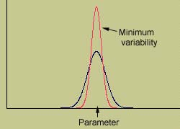
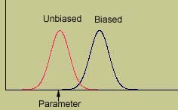
Properties of
Point Estimators
Of all the unbiased estimators, we prefer the estimator whose sampling distribution has the smallest spread or variability.

Slide 10
Measuring the Goodness of an Estimator
The distance between an estimate and the true value of the parameter is the error of estimation.
The distance between the bullet and the bull’s-eye.
In this chapter, the sample sizes are large, so that our unbiased estimators will have normal distributions.
Because of the Central Limit Theorem.

Slide 11
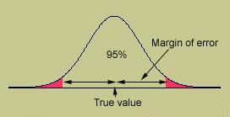
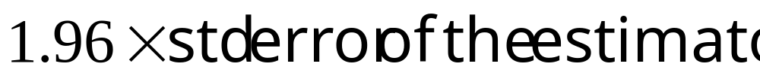
The Margin of Error
For unbiased estimators with normal sampling distributions, 95% of all point estimates will lie within 1.96 standard deviations of the parameter of interest.
Margin of error: The maximum error of estimation, calculated as

Slide 12
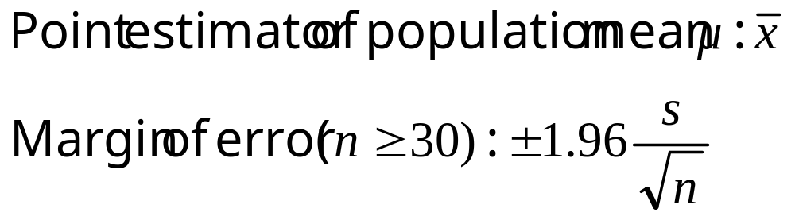
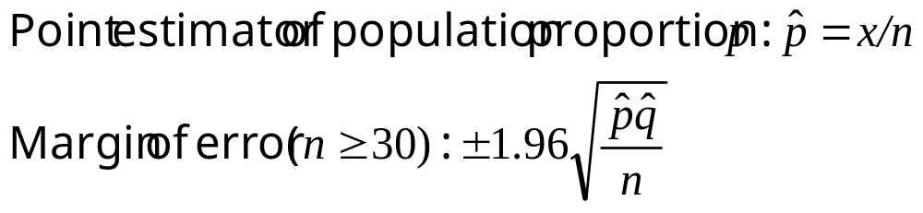
Estimating Means and Proportions
For a quantitative population,
For a binomial population,

Slide 13
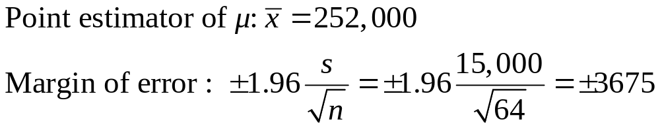
Example
A homeowner randomly samples 64 homes similar to her own and finds that the average selling price is $252,000 with a standard deviation of $15,000. Estimate the average selling price for all similar homes in the city.

Slide 14

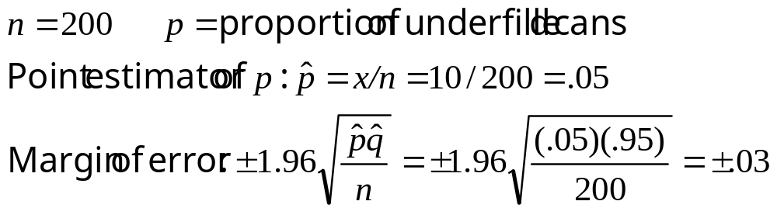
Example
A quality control technician wants to estimate
the proportion of soda cans that are underfilled.
He randomly samples 200 cans of soda and finds 10 underfilled cans.

Slide 15
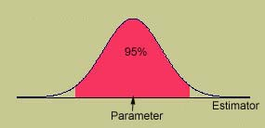
Interval Estimation
Create an interval (a, b) so that you are fairly sure that the parameter lies between these two values.
“Fairly sure” is means “with high probability”, measured using the confidence coefficient, 1−α.
Usually, 1-α = .90, .95, .98, .99
Suppose 1-α = .95 and that the estimator has a normal distribution.
Parameter ± 1.96SE

Slide 16
Interval Estimation
Since we don’t know the value of the parameter, consider which has a variable center.
Estimator ± 1.96SE
MY
APPLET
Worked
Worked
Worked
Failed
Only if the estimator falls in the tail areas will the interval fail to enclose the parameter. This happens only 5% of the time.

Slide 17
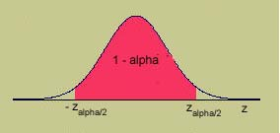
To Change the Confidence Level
To change to a general confidence level, 1-α, pick a value of z that puts area 1-α in the center of the z distribution.
Tail area | z_{α/2}
.05 | 1.645
.025 | 1.96
.01 | 2.33
.005 | 2.58
100(1-α)% Confidence Interval: Estimator ± z_{α/2}SE

Slide 18
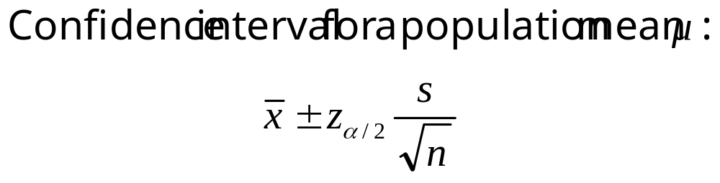
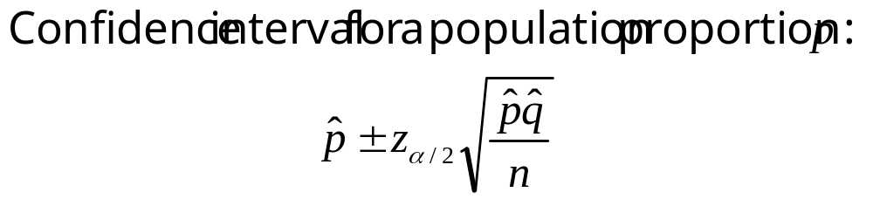
Confidence Intervals for Means and Proportions
For a quantitative population,
For a binomial population,

Slide 19

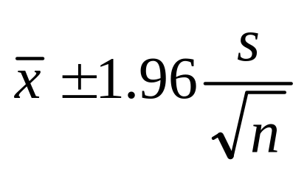
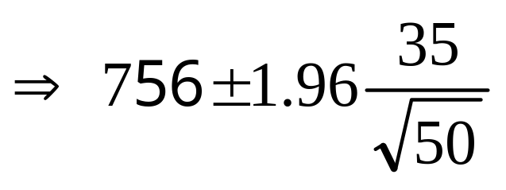
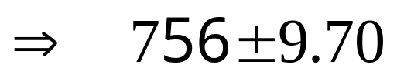
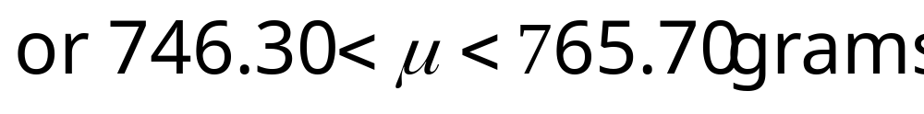
Example
A random sample of n = 50 males showed a mean average daily intake of dairy products equal to 756 grams with a standard deviation of 35 grams. Find a 95% confidence interval for the population average μ.

Slide 20
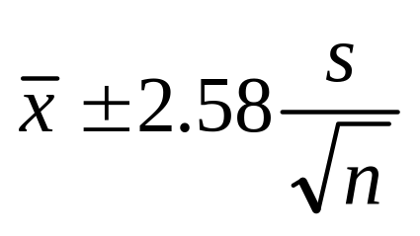
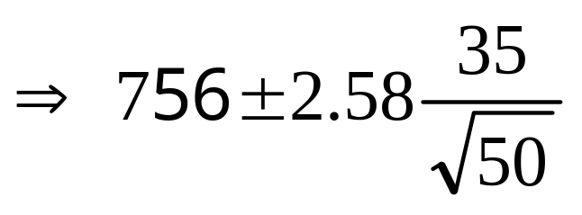
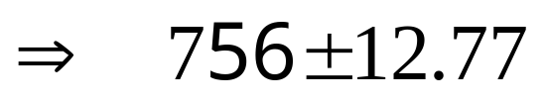
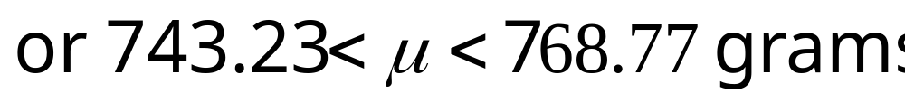
Example
Find a 99% confidence interval for μ, the population average daily intake of dairy products for men.
The interval must be wider to provide for the increased confidence that is does indeed enclose the true value of μ.

Slide 21

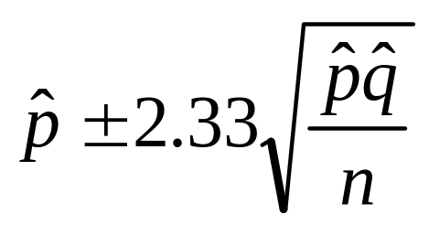
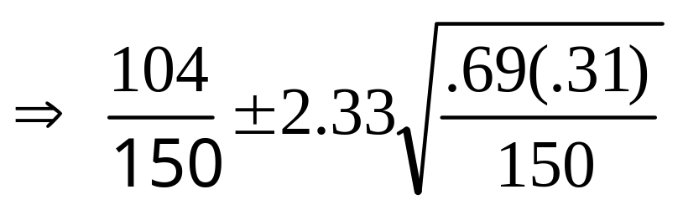
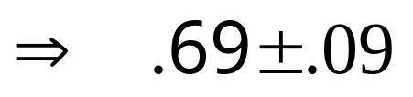
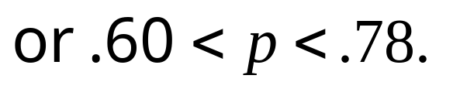
Example
Of a random sample of n = 150 college students, 104 of the students said that they had played on a soccer team during their K-12 years. Estimate the porportion of college students who played soccer in their youth with a 98% confidence interval.

Slide 22
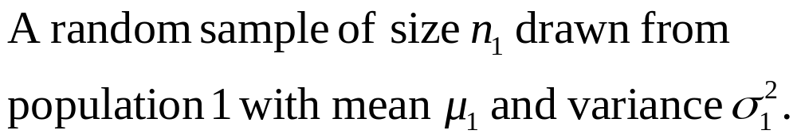
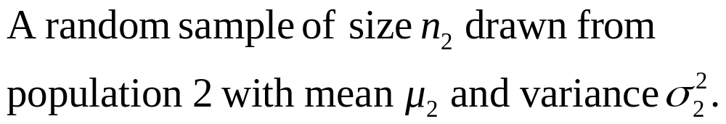
Estimating the Difference between Two Means
Sometimes we are interested in comparing the means of two populations.
  The average growth of plants fed using two different nutrients.
  The average scores for students taught with two different teaching methods.
To make this comparison,

Slide 23
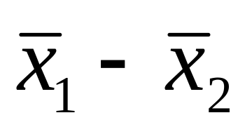
Estimating the Difference between Two Means
We compare the two averages by making inferences about μ₁-μ₂, the difference in the two population averages.
  If the two population averages are the same, then μ₁-μ₂ = 0.
  The best estimate of μ₁-μ₂ is the difference in the two sample means,

Slide 24
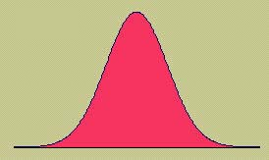
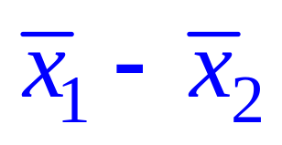
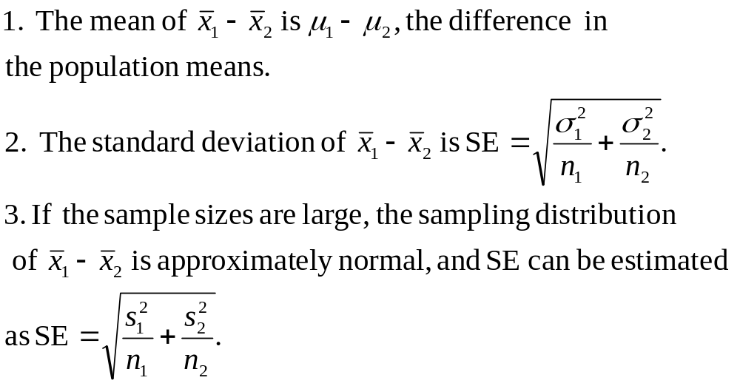
The Sampling Distribution of

Slide 25
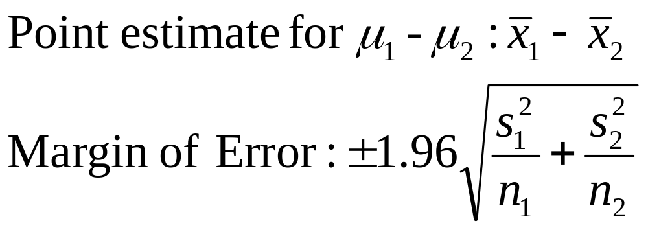
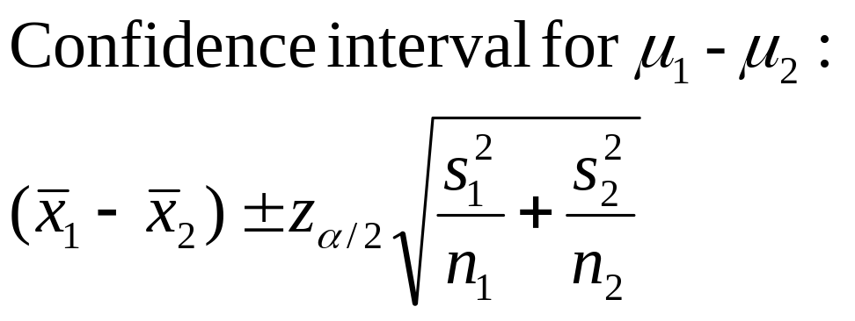
Estimating μ₁-μ₂
For large samples, point estimates and their margin of error as well as confidence intervals are based on the standard normal (z) distribution.

Slide 26
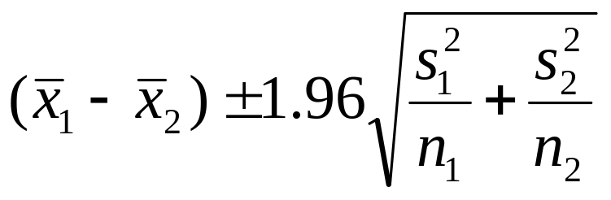
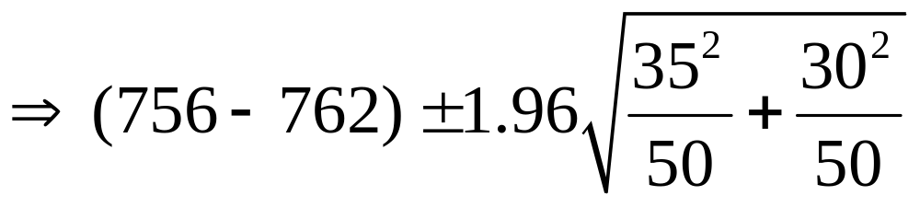

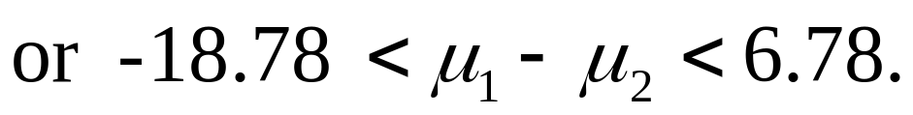
Example
Avg Daily Intakes | Men | Women
Sample size | 50 | 50
Sample mean | 756 | 762
Sample Std Dev | 35 | 30
Compare the average daily intake of dairy products of men and women using a 95% confidence interval.

Slide 27
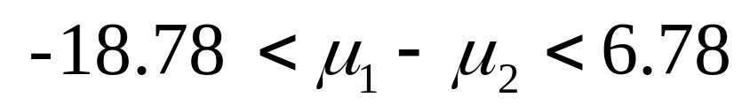
Example, continued
Could you conclude, based on this confidence interval, that there is a difference in the average daily intake of dairy products for men and women?
The confidence interval contains the value μ₁-μ₂= 0. Therefore, it is possible that μ₁ = μ_{2.} You would not want to conclude that there is a difference in average daily intake of dairy products for men and women.

Slide 28
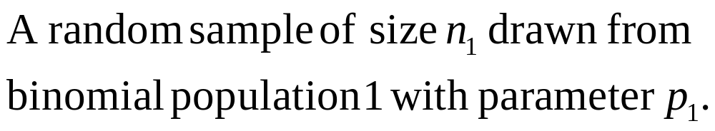
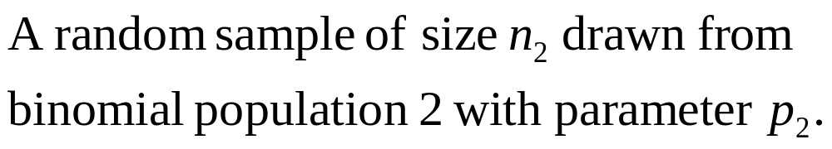
Estimating the Difference between Two Proportions
Sometimes we are interested in comparing the proportion of “successes” in two binomial populations.
  The germination rates of untreated seeds and seeds treated with a fungicide.
  The proportion of male and female voters who favor a particular candidate for governor.
To make this comparison,

Slide 29
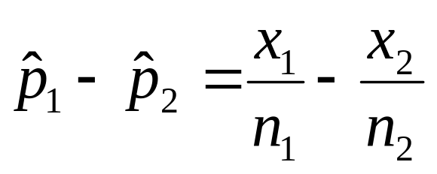
Estimating the Difference between Two Means
We compare the two proportions by making inferences about p₁-p₂, the difference in the two population proportions.
  If the two population proportions are the same, then p₁-p₂ = 0.
  The best estimate of p₁-p₂ is the difference in the two sample proportions,

Slide 30
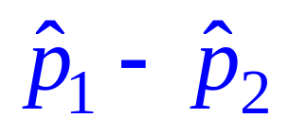
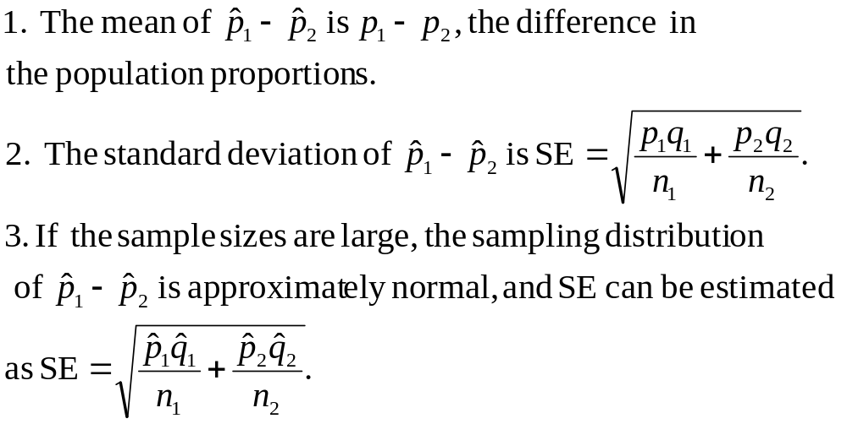
The Sampling Distribution of

Slide 31
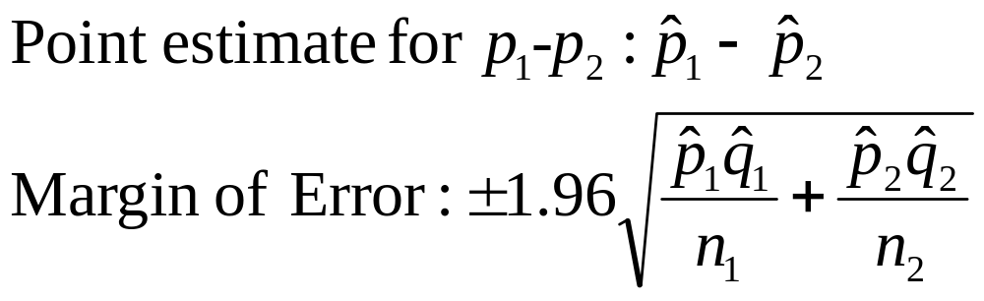
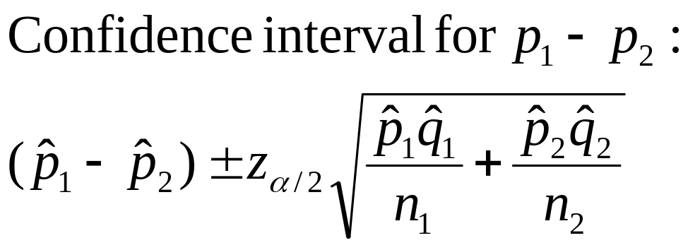
Estimating p₁-p₂
For large samples, point estimates and their margin of error as well as confidence intervals are based on the standard normal (z) distribution.

Slide 32
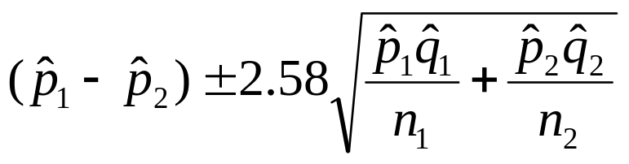
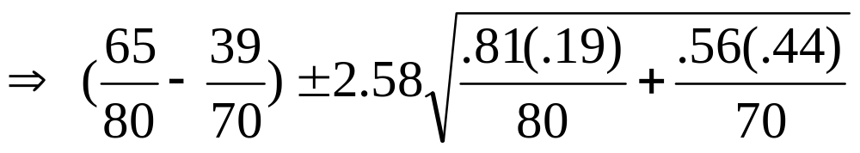

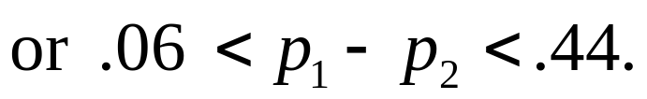
Example
Youth Soccer | Male | Female
Sample size | 80 | 70
Played soccer | 65 | 39
Compare the proportion of male and female college students who said that they had played on a soccer team during their K-12 years using a 99% confidence interval.

Slide 33
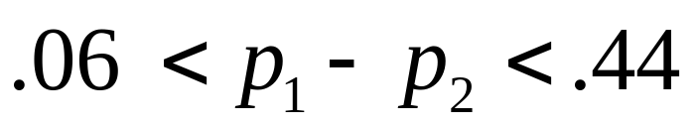
Example, continued
Could you conclude, based on this confidence interval, that there is a difference in the proportion of male and female college students who said that they had played on a soccer team during their K-12 years?
The confidence interval does not contains the value p₁-p₂ = 0. Therefore, it is not likely that p₁= p_{2.} You would conclude that there is a difference in the proportions for males and females.
A higher proportion of males than females played soccer in their youth.

Slide 34
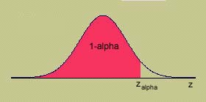

One Sided
Confidence Bounds
Confidence intervals are by their nature two-sided since they produce upper and lower bounds for the parameter.
One-sided bounds can be constructed simply by using a value of z that puts α rather than α/2 in the tail of the z distribution.

Slide 35

Choosing the Sample Size
The total amount of relevant information in a sample is controlled by two factors:
- The sampling plan or experimental design: the procedure for collecting the information
- The sample size n: the amount of information you collect.
In a statistical estimation problem, the accuracy of the estimation is measured by the margin of error or the width of the confidence interval.

Slide 36
Choosing the Sample Size
Determine the size of the margin of error, B, that you are willing to tolerate.
Choose the sample size by solving for n or n = n ₁ = n₂ in the inequality: 1.96 SE ≤ B, where SE is a function of the sample size n.
For quantitative populations, estimate the population standard deviation using a previously calculated value of s or the range approximation σ ≈ Range / 4.
For binomial populations, use the conservative approach and approximate p using the value p = .5.

Slide 37




Example
A producer of PVC pipe wants to survey
wholesalers who buy his product in order to
estimate the proportion who plan to increase their purchases next year. What sample size is required if he wants his estimate to be within .04 of the actual proportion with probability equal to .95?
He should survey at least 601 wholesalers.

Slide 38
Key Concepts
I. Types of Estimators
1. Point estimator: a single number is calculated to estimate the population parameter.
2. Interval estimator: two numbers are calculated to form an interval that contains the parameter.
II. Properties of Good Estimators
1. Unbiased: the average value of the estimator equals the parameter to be estimated.
2. Minimum variance: of all the unbiased estimators, the best estimator has a sampling distribution with the smallest standard error.
3. The margin of error measures the maximum distance between the estimator and the true value of the parameter.

Slide 39

Key Concepts
III. Large-Sample Point Estimators
To estimate one of four population parameters when the sample sizes are large, use the following point estimators with the appropriate margins of error.

Slide 40

Key Concepts
IV. Large-Sample Interval Estimators
To estimate one of four population parameters when the sample sizes are large, use the following interval estimators.

Slide 41
Key Concepts
All values in the interval are possible values for the unknown population parameter.
Any values outside the interval are unlikely to be the value of the unknown parameter.
To compare two population means or proportions, look for the value 0 in the confidence interval. If 0 is in the interval, it is possible that the two population means or proportions are equal, and you should not declare a difference. If 0 is not in the interval, it is unlikely that the two means or proportions are equal, and you can confidently declare a difference.
V. One-Sided Confidence Bounds
Use either the upper (+) or lower (−) two-sided bound, with the critical value of z changed from z_{α / 2} to z_{α}.

